Slide 1
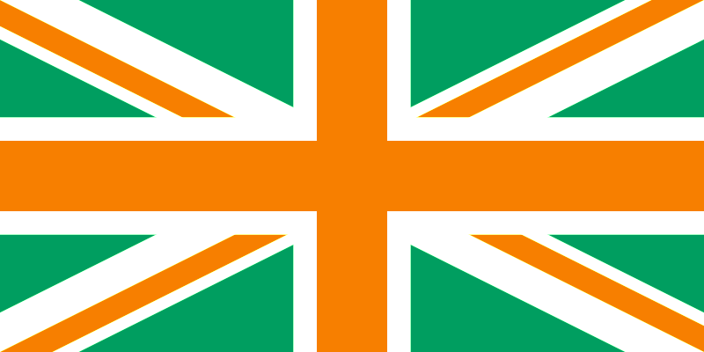
Irish immigration to Briton

Slide 2
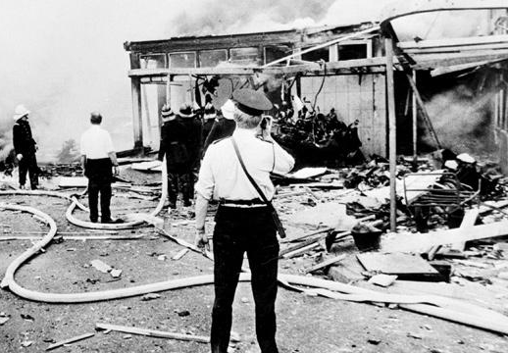
The History
1916 – «the beginning»
Northern Ireland
Afterwards
Bloody Days

Slide 3

Irish in Britain
Quiet
Prejudice
Two stories
Hatred
Internet, a tool
Their own party
What they do

Slide 4
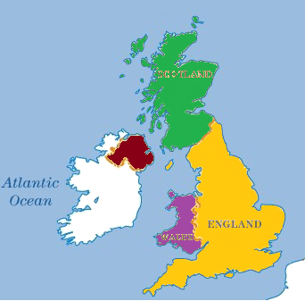
Distribution
Colour | Irish population in region
Red | 25.26%
Yellow | 0.64%
Green | 0.41%
Purple | 0.32%
Colour | Irish population in region
Red | 505 200
Yellow | 339 200
Green | 20 500
Purple | 9 600
measured 2011

Slide 5
Kilder =)
http://www.foxnews.com/world/2014/04/08/century-conflict-and-compromise-key-events-in-relations-between-britain-and/
http://en.wikipedia.org/wiki/Bloody_Friday_%281972%29
http://www.ibtimes.com/anti-irish-hatred-yes-pockets-still-exist-britain-729873
http://www.irishinbritain.org/what-we-do/what-we-do
http://www.indymedia.ie/attachments/apr2006/irelandengland.jpg
http://en.wikipedia.org/wiki/Demography_of_the_United_Kingdom#National_Identity
http://en.wikipedia.org/wiki/Northern_Ireland
http://en.wikipedia.org/wiki/Scotland
http://en.wikipedia.org/wiki/England
http://en.wikipedia.org/wiki/Wales

